Slide 1
Lesson 1
Computer Vision

Slide 2
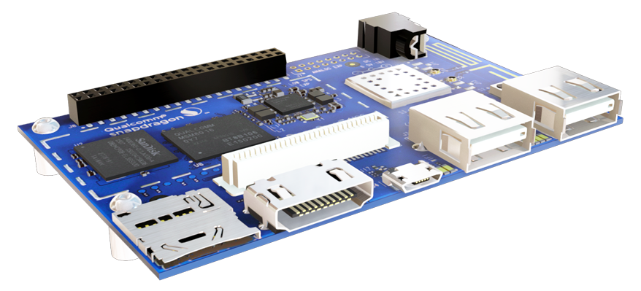
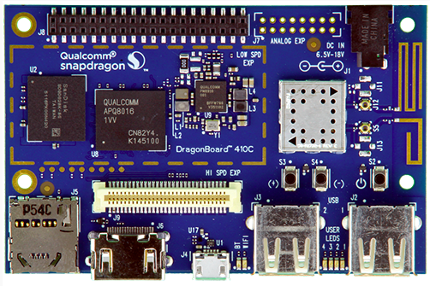
Lesson 1 | Computer Vision
1 - What is Computer Vision?
2 - Applications of CV

Slide 3
BREAK
Q:?
a).
b).
c).
d).
e).

Slide 4
1 - What is Computer Vision?

Slide 5
1 | What is Computer Vision?
Computer Vision - processing and analyzing images
for research, gathering data, to change colors, image editing
Can be described as trying to recreate human vision
create a system that can do what the human eye and brain does
perform tasks such as:
recognition
decision making
Many different kinds of libraries
OpenCV
SimpleCV
FastCV

Slide 6
BREAK
Q:?
a).
b).
c).
d).
e).

Slide 7
2 - Applications of CV

Slide 8
2 | Applications of CV
Remember, thanks to the use of libraries, we can create CV applications without writing code to use a camera or perform other basic, general functions (e.g. color change)
Some cool things:
Facial recognition
Filters - color changes, hues, etc
Snapchat, Instagram, etc.
Shape detection
Any other kinds of information you can get from an image or you can modify in an image
What other things could you do or create with a CV application?
Notes:
Controlling processes, e.g., an industrial robot;
Navigation, e.g., by an autonomous vehicle or mobile robot;
Detecting events, e.g., for visual surveillance or people counting;
Organizing information, e.g., for indexing databases of images and image sequences;
Modeling objects or environments, e.g., medical image analysis or topographical modeling;
Interaction, e.g., as the input to a device for computer-human interaction, and
Automatic inspection, e.g., in manufacturing applications.

Slide 9
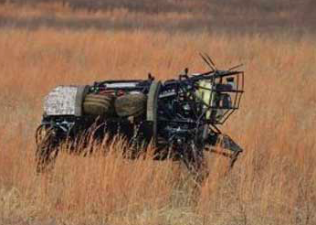
2 | Applications of CV
DARPA awarded Boston Dynamics with a $9,983,844 contract in order to
produce the “AlphaDog” robot.
Made to unburden military squad members by carrying their gear
Robot will autonomously follow members through rugged terrain
Capable of interpreting verbal and visual commands.
Notes:
Controlling processes, e.g., an industrial robot;
Navigation, e.g., by an autonomous vehicle or mobile robot;
Detecting events, e.g., for visual surveillance or people counting;
Organizing information, e.g., for indexing databases of images and image sequences;
Modeling objects or environments, e.g., medical image analysis or topographical modeling;
Interaction, e.g., as the input to a device for computer-human interaction, and
Automatic inspection, e.g., in manufacturing applications.

Slide 10
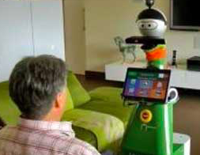
2 | Applications of CV
Highly-customizable semi-humanoid robots
Talk and provide cognitive support to users
Equipped with cameras, sensors and touchscreen interfaces
Reminders, suggestions, prompts, scheduling etc...
Mobiserv robot companions are highly-customizable semi-humanoid robots which can talk and provide cognitive support to users by offering them reminders and suggestions throughout the day. The robots are equipped with cameras, sensors, and a touch screen interface, and can interact with users in a number of ways, including reminding them to take their medicine, suggest they have their favorite drink, or prompt them to go for a walk or visit friends if they haven't been out in a while.
Notes:
Controlling processes, e.g., an industrial robot;
Navigation, e.g., by an autonomous vehicle or mobile robot;
Detecting events, e.g., for visual surveillance or people counting;
Organizing information, e.g., for indexing databases of images and image sequences;
Modeling objects or environments, e.g., medical image analysis or topographical modeling;
Interaction, e.g., as the input to a device for computer-human interaction, and
Automatic inspection, e.g., in manufacturing applications.

Slide 11
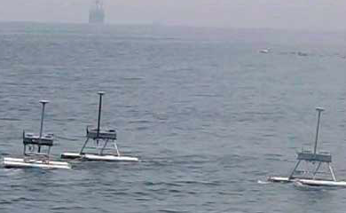
2 | Applications of CV
Unmanned aquatic robots: Jellyfish elimination robotic swarm (JEROS)
Jellyfish population control
Floats on surface of the water on two cylindrical bodies, motors used for movement.
Onboard camera detects jellyfish swarms.
Notes:
Controlling processes, e.g., an industrial robot;
Navigation, e.g., by an autonomous vehicle or mobile robot;
Detecting events, e.g., for visual surveillance or people counting;
Organizing information, e.g., for indexing databases of images and image sequences;
Modeling objects or environments, e.g., medical image analysis or topographical modeling;
Interaction, e.g., as the input to a device for computer-human interaction, and
Automatic inspection, e.g., in manufacturing applications.

Slide 12
Lesson 1 | Summary + A Look Back
1 - What is Computer Vision?
2 - Applications of CV

Slide 13
Lesson 2
SimpleCV and OpenCV

Slide 14
Lesson 2 | SimpleCV and OpenCV
1 - SimpleCV vs OpenCV
2 - Setting Up
Initial Setup
Debugging

Slide 15
BREAK
Q:?
a).
b).
c).
d).
e).

Slide 16
1 - SimpleCV vs OpenCV

Slide 17


1 | SimpleCV vs OpenCV
Two easy to access libraries for creating computer
vision programs
Since we are using Python, either of these will work
We are using SimpleCV (feel free to mimic the program in OpenCV!)
Both are open sourced with tons of documentation
SimpleCV uses OpenCV (making some functions simpler to use)
SimpleCV: http://simplecv.org/ and http://simplecv.sourceforge.net/doc/index.html
OpenCV: http://opencv.org/
- what about the differences?

Slide 18
1 | SimpleCV vs OpenCV
Why SimpleCV?
Interactive shell for testing
Great for quick demonstration purposes
Works very well with Python
Good place to start
Simple!!
What about OpenCV?
Libraries for most other languages (C, C++, Python, etc.)
Great for large scale programs
Honorable mention: Qualcomm’s FastCV

Slide 19
BREAK
Q:?
a).
b).
c).
d).
e).

Slide 20
2 - Setting Up

Slide 21
2 | Setting Up
Working in Python, requires Linux boot
Forgot how to switch your OS? Check out the documentation or Course 2!
Remember to backup or save your applications/data if you change your OS
Note that OpenCV has libraries in C/C++ and Java as well (remember the NDK and OpenCV C++ libraries?) to build an Android CV App
JavaCV is a wrapper that uses the OpenCV C++; but sometimes you won’t get the full functionality of true OpenCV
After you boot up your board with the Linux based environment…
Notes:
camera issues

Slide 22
2 | Setting Up
Get connected to the internet (e.g. WiFi on the bottom right)
Remember, this is just like a regular PC now
In start menu on the bottom right, launch “LXTerminal” (under “System Tools”)
Commands to use:
sudo apt-get update
sudo apt-get upgrade
sudo apt-get install ipython python-opencv python-scipy python-numpy python-pygame python-setuptools python-pip python-dev
So far, we’ve installed most of the Python related libraries to get started with creating an application using the SimpleCV library

Slide 23
2 | Setting Up
Next, we need Pillow (updated version of PIL - Python Imaging Library) along with image file format supports
sudo apt-get install libjpeg-dev libtiff-dev libfreetype6-dev zlib1g-dev
sudo pip install Pillow
Finally, SimpleCV:
git clone https://github.com/sightmachine/SimpleCV.git
cd SimpleCV/
sudo pip install svgwrite
sudo python setup.py install
Now we’re ready to start developing!
test with simplecv command
“sudo apt-get install idle” for the idle3 python editor

Slide 24
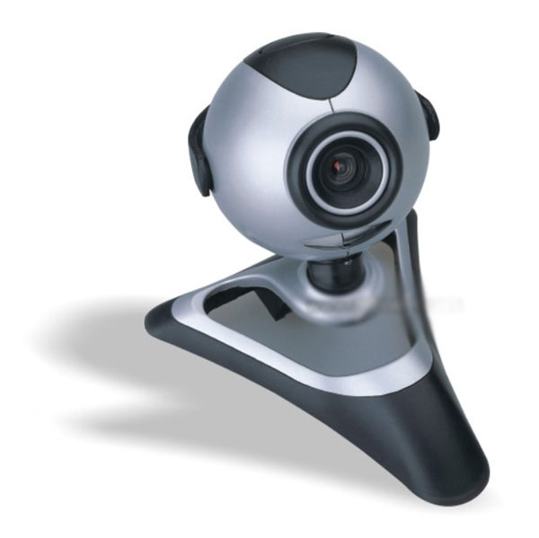
2 | Setting Up
SimpleCV Setup Debugging Tips
double check if all necessary libraries are installed
try sudo apt-get update && sudo apt-get upgrade again
make sure you have Pillow (the updated version of PIL)
needs all the correct imaging libraries
Camera Debugging Tips
using the terminal
without your camera, execute ls /dev/video*
now, with your camera, execute ls /dev/video*
your camera should appear in as a new video#
check if it plays using something like cheese or VLC
make sure it’s support by the board or Linux
check if you have Pillow or any of the necessary imaging libraries

Slide 25
2 | Setting Up
Still have SimpleCV issues? or Pillow issues?
might need to set up some system links
sudo ln -s /usr/lib/x86_64-linux-gnu/libz.so /usr/lib/libz.so
sudo ln -s /usr/lib/x86_64-linux-gnu/libjpeg.so /usr/lib/libjpeg.so
sudo ln -s /usr/lib/x86_64-linux-gnu/libfreetype.so /usr/lib/libfreetype.so
check the requirements.txt in the SimpleCV download directory
cat requirements.txt to see which libraries you will need to install (using pip)
check the forums!
ask or answer questions

Slide 26
Lesson 2 | Summary + A Look Back
1 - SimpleCV vs OpenCV
Similarities
Differences
2 - Setting Up
Initial setup
Debugging tips

Slide 27
Lesson 3
SimpleCV Application

Slide 28
Lesson 3 | Simple OpenCV Application
1 - Basic Application
Make Sure the Camera Works
2 - Adding Features
Additions to the Basic App
3 - Server Setup

Slide 29
BREAK
Q:?
a).
b).
c).
d).
e).

Slide 30
1 - Basic Application
Notes:
camera taking pictures

Slide 31
1 | Basic Application
1 -

Slide 32
BREAK
Q:?
a).
b).
c).
d).
e).

Slide 33
2 - Adding Features

Slide 34
2 | Adding Features
1 -
Notes:
multi cam
facial recognition
scanning

Slide 35
BREAK
Q:?
a).
b).
c).
d).
e).

Slide 36
3 - Server Setup

Slide 37
3 | Server Setup
sudo apt-get install cron
constant photo updates

Slide 38
Lesson 3 | Summary + A Look Back
1 - Basic Application
Make Sure the Camera Works
2 - Adding Features
Facial Recognition
Color Filter
3 - Server Setup
Be Able to See Pictures Remotely

